Slide 1
Csa0509- database management SYSTEMS
GUIDED BY:
Dr.R.Kesavan
PRESENTED BY M.SHARMILA(192572139)

Slide 2


An ER Diagram for an Online Library System
An Entity Relationship (ER) Diagram is a graphical representation used to design the logical structure of a database.
It identifies entities, attributes, relationships, and constraints before implementation.
In an Online Library Management System, an ER diagram helps organize information
It serves as a blueprint for database developers.

Slide 3
OBJECTIVES
Store library information efficiently.
Track issued and returned books.
Manage members and authors.
Maintain accurate borrowing records.

Slide 4
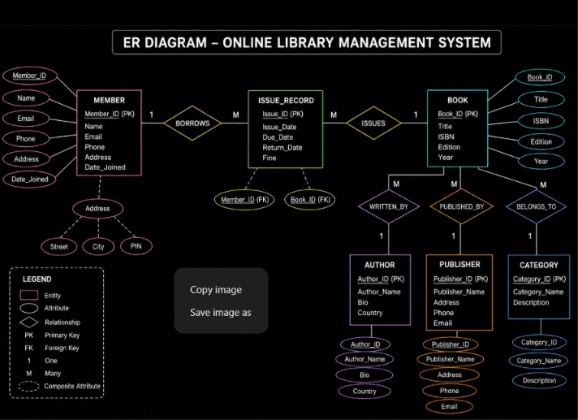

Slide 5
ADVANTAGES
Eliminates data redundancy
Maintains data integrity
Easy to understand
Supports efficient database design
Improves query performance
Helps normalize the database

Slide 6
2.Demonstrating Generalization and Specialization with a University Case Study.
The Extended Entity-Relationship (EER) Model is an enhanced version of the ER model that provides advanced concepts such as inheritance, specialization, generalization, and aggregation. It is used to represent complex real-world database structures more effectively.

Slide 7
FEATURES
Extension of the ER model
Supports inheritance
Reduces redundancy
Models complex relationships
Improves database design

Slide 8
APPLICATIONS
University Management Systems
Hospital Management Systems
Banking Systems
E-Commerce Application

Slide 9
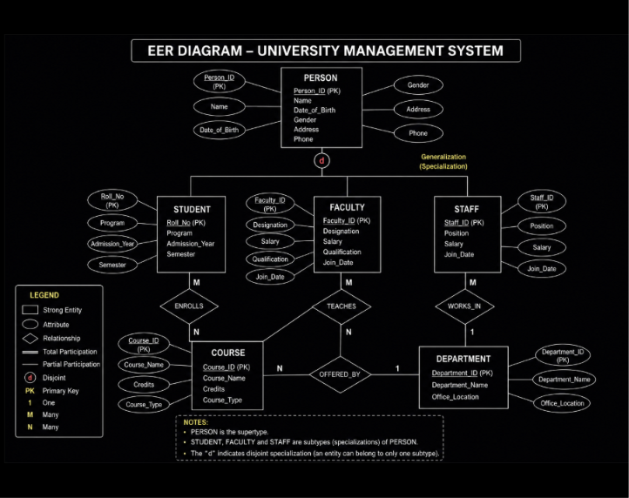

Slide 10
3.concept of Data Independence (Logical and Physical) and its significance in DBMS Architecture.
Data Independence is the ability to modify the database schema at one level without affecting the schema at the next higher level. It allows changes in the database structure while minimizing the impact on applications and users.

Slide 11
OBJECTIVES
Reduce application maintenance
Improve flexibility
Support database scalability
Simplify database management

Slide 12
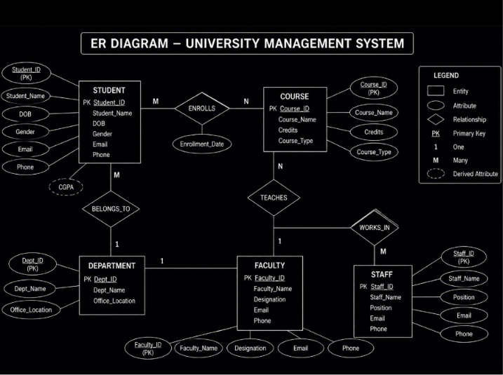

Slide 13
4.software Components of a DBMS, Explaining Query Processor, Storage Manager, and Transaction Manager.
A Database Management System (DBMS) consists of several software components that work together to store, retrieve, manage, and protect data efficiently. These components ensure fast query processing, secure transactions, and reliable data storage.

Slide 14
Objectives
Efficient data retrieval
Secure data storage
Concurrent user access
Data consistency and reliability

Slide 15
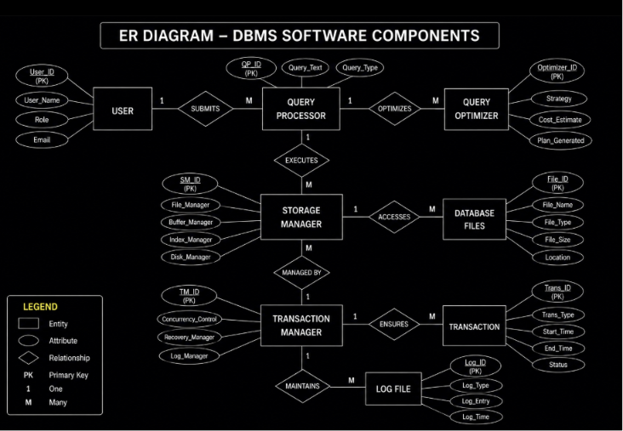

Slide 16
5.Comparing Strong and Weak Entities in ER Modeling with Real-World Examples.
An Entity is a real-world object about which information is stored in a database. In an Entity-Relationship (ER) model, entities are classified into Strong Entities and Weak Entities based on whether they can be uniquely identified by their own attributes

Slide 17
Strong Entity vs Weak Entity
Strong Entity | Weak Entity
Has its own Primary Key | Does not have a complete Primary Key
Exists independently | Depends on a Strong Entity
Single Rectangle | Double Rectangle
Normal Relationship | Identifying Relationship
Primary Key | Partial Key
Example: Employee | Example: Dependent
Strong Entity | Weak Entity
Has its own Primary Key | Does not have a complete Primary Key
Exists independently | Depends on a Strong Entity
Single Rectangle | Double Rectangle
Normal Relationship | Identifying Relationship
Primary Key | Partial Key
Example: Employee | Example: Dependent
Strong Entity vs Weak Entity

Slide 18
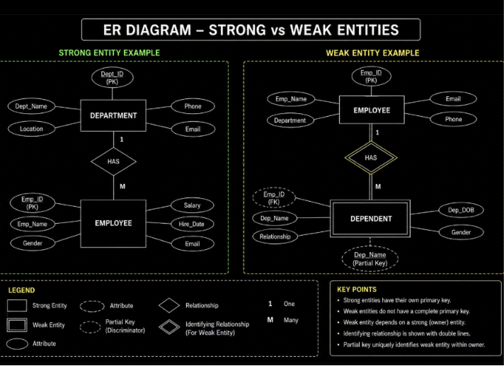

Slide 19
THANK YOU

